Slide 1
Pre Work 3

Slide 2
Agenda
S.No | Topic
1 | For Loop
2 | While Loop
3 | Do While Loop
4 | Continue Statement
5 | Break Statement

Slide 3
For Loop
Loop control is an essential part of Java programming, allowing developers to create programs that execute a set of instructions repeatedly until a certain condition is met.
For loop: Syntax
for(initialization; condition; increment/decrement) {
/ code to be executed
}
The initialization, condition, and increment/decrement expressions are optional, but at least one of them must be present. The initialization expression is executed once at the beginning of the loop, the condition expression is checked before each iteration, and the

Slide 4
While Loop
Syntax:
while(condition) {
// code to be executed
}
The condition is checked before each iteration of the loop, and the code block will be executed if it is true. The loop will be exit if the condition is not true.
int x = 5;
while(x > 0) {
System.out.println(x);
x--;
}
This while loop will print the numbers 5 through 1 to the console.

Slide 5
Do While Loop
Do-while loops are similar to while loops, but the code block is guaranteed to be executed at least once. The basic syntax of a do-while loop is: Syntax:
do {
// code to be executed
} while(condition);

Slide 6
Continue
The Java continue statement is used to continue the loop. It continues the current flow of the program and skips the remaining code at the specified condition. In case of an inner loop, it continues the inner loop only.
We can use Java continue statement in all types of loops such as for loop, while loop and do-while loop.
Syntax:
jump-statement;
continue;

Slide 7
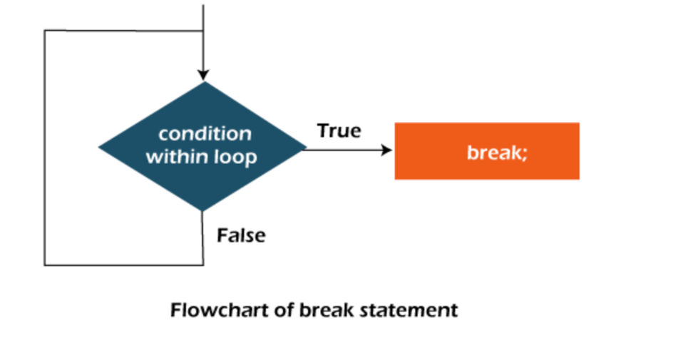
Break Statement
The Java break statement is used to break loop or switch statement. It breaks the current flow of the program at specified condition. In case of inner loop, it breaks only inner loop.
We can use Java break statement in all types of loops such as for loop, while loop and do-while loop.
Syntax:
jump-statement;
break;

Slide 8
Thank You
Proprietary content. ©Great Learning. All Rights Reserved. Unauthorized use or distribution prohibited

